Slide 1

Artificial Neural Networks - Introduction -
B.E. ACADEMIC UNIT -2 CHANDIGARH UNIVERSITY, MOHALI
Prepared By : Ms. Mehak Sood
Birinderjit Singh Kalyan
EE
Assistant Professor
Innovation and Inventions CST 156
1
1
www. cuchd.in Campus : Gharuan, Mohali
www. cuchd.in Campus : Gharuan, Mohali
Innovation and Inventions CST 156
www. cuchd.in Campus : Gharuan, Mohali

Slide 2
Innovations & Inventions in Computer Science & Engineering/ Information Technology CST-156
Innovation and Inventions CST 156
2
2
2
www. cuchd.in Campus : Gharuan, Mohali
www. cuchd.in Campus : Gharuan, Mohali
www. cuchd.in Campus : Gharuan, Mohali
Innovation and Inventions CST 156
www. cuchd.in Campus : Gharuan, Mohali

Slide 3
Prerequisite
Basic Knowledge of Computer Technology
Innovation and Inventions CST 156
3
3
www. cuchd.in Campus : Gharuan, Mohali
www. cuchd.in Campus : Gharuan, Mohali
Innovation and Inventions CST 156
www. cuchd.in Campus : Gharuan, Mohali

Slide 4
Syllabus
Unit-I
Introduction - Innovation, Inventions And Discovery, Invention - Necessity Examples, Inventions Of the Past And Present, Innovation - Definition, Need For Innovation, Comparison Of Innovations And Inventions.[3 hours]
Classification of Innovation - Based On Category - Product Innovation, Process Innovation, Service Innovation, Marketing Innovation, Organizational Innovation, Based On Overall Global Needs - Technological Innovation, Social Innovation, Based On The Degree Of Novelty - Incremental Innovations, Radical Innovations, Systemic / Systematic Innovations.[4 hours]
Need For Innovation - Business needs, social needs, Technological, Scientific and other needs. [3 hours]
Innovation and Inventions CST 156
4
4
www. cuchd.in Campus : Gharuan, Mohali
www. cuchd.in Campus : Gharuan, Mohali
Innovation and Inventions CST 156
www. cuchd.in Campus : Gharuan, Mohali

Slide 5
Syllabus
Unit-II
Stages to implement the innovation - Concept building, idea generation, product screening, concept testing, market survey, prototyping, test marketing, Commercialisation.[4 hours]
Safeguarding Innovation - Methods of protection, copy right, trademarks, Intellectual Property Rights (IPR). Method of Protection, Procedure for IPR. [4 hours ]
Case Studies: Various case studies of the innovations in the field of Computer Science and Engineering in the past years.[2 hours]
Innovation and Inventions CST 156
5
5
www. cuchd.in Campus : Gharuan, Mohali
www. cuchd.in Campus : Gharuan, Mohali
Innovation and Inventions CST 156
www. cuchd.in Campus : Gharuan, Mohali

Slide 6
Syllabus
Unit-III
New Trends in the field of C.S.E/ I.T :
Cloud Computing - Introduction, Characteristics, Service Models, Benefits, application. [3 hours]
Big Data - Introduction, characteristics, 3V’s, Tools & Techniques, applications. [3 hours]
Machine Learning--- Introduction, characteristics, Learning Process, Categories, application areas. [4 hours]
Innovation and Inventions CST 156
6
6
www. cuchd.in Campus : Gharuan, Mohali
www. cuchd.in Campus : Gharuan, Mohali
Innovation and Inventions CST 156
www. cuchd.in Campus : Gharuan, Mohali

Slide 7
Recommended books
1. An Engineer's Guide to Invention and Innovation,Cawas Phiroze Nazir
2. Creative Development: Transforming Education Through Design Thinking, Innovation, and Invention , Robert Kelly
Innovation and Inventions CST 156
7
7
www. cuchd.in Campus : Gharuan, Mohali
www. cuchd.in Campus : Gharuan, Mohali
Innovation and Inventions CST 156
www. cuchd.in Campus : Gharuan, Mohali

Slide 8
Applications
Invention leads to development of new products.
Innovation is applied to improve existing products/services.
Innovation meets new requirements, unarticulated needs, or existing market needs.
www. cuchd.in Campus : Gharuan, Mohali

Slide 9
Learning Objectives
Analyze about the new technology Big data tools , techniques, applications.
Innovation and Inventions CST 156
9
9
www. cuchd.in Campus : Gharuan, Mohali
www. cuchd.in Campus : Gharuan, Mohali
www. cuchd.in Campus : Gharuan, Mohali
Innovation and Inventions CST 156
www. cuchd.in Campus : Gharuan, Mohali

Slide 10
Learning Outcomes
Analyzed about the new technology Big data tools , techniques, applications.
Innovation and Inventions CST 156
10
10
www. cuchd.in Campus : Gharuan, Mohali
www. cuchd.in Campus : Gharuan, Mohali
www. cuchd.in Campus : Gharuan, Mohali
Innovation and Inventions CST 156
www. cuchd.in Campus : Gharuan, Mohali

Slide 11
Course Outcomes
Analyze the importance, classification, and need of innovation in various fields.
Analyze procedure to implement the innovation and the techniques to safeguard the innovation.
Study various emerging technology trends in the field of CSE/IT.
Innovation and Inventions CST 156
11
11
www. cuchd.in Campus : Gharuan, Mohali
www. cuchd.in Campus : Gharuan, Mohali
Innovation and Inventions CST 156
www. cuchd.in Campus : Gharuan, Mohali
www. cuchd.in Campus : Gharuan, Mohali

Slide 12
BIG DATA
Big data is the term for a collection of data sets so large and complex that it becomes difficult to process using on-hand database management tools or traditional data processing applications.
The challenges include capture, curation, storage, search, sharing, transfer, analysis, and visualization.
The trend to larger data sets is due to the additional information derivable from analysis of a single large set of related data, as compared to separate smaller sets with the same total amount of data, allowing correlations to be found to "spot business trends, determine quality of research, prevent diseases, link legal citations, combat crime, and determine real-time roadway traffic conditions.”
Innovation and Inventions CST 156
12
12
12
www. cuchd.in Campus : Gharuan, Mohali
www. cuchd.in Campus : Gharuan, Mohali
www. cuchd.in Campus : Gharuan, Mohali
Innovation and Inventions CST 156
www. cuchd.in Campus : Gharuan, Mohali

Slide 13
Characteristics of Big data
Fig no.1 Characterization of Big Data [1]
Innovation and Inventions CST 156
13
13
www. cuchd.in Campus : Gharuan, Mohali
www. cuchd.in Campus : Gharuan, Mohali
www. cuchd.in Campus : Gharuan, Mohali
Innovation and Inventions CST 156
www. cuchd.in Campus : Gharuan, Mohali

Slide 14

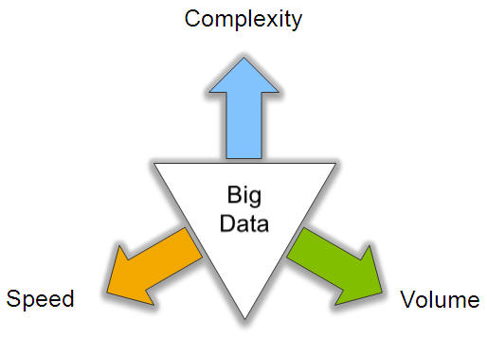
Big Data: 3V’s
Fig no.2 3 V’s of big data [2]
Innovation and Inventions CST 156
14
14
14
www. cuchd.in Campus : Gharuan, Mohali
www. cuchd.in Campus : Gharuan, Mohali
www. cuchd.in Campus : Gharuan, Mohali
Innovation and Inventions CST 156
www. cuchd.in Campus : Gharuan, Mohali

Slide 15


Slide 16
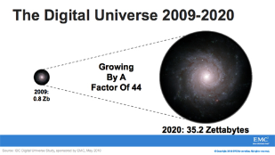

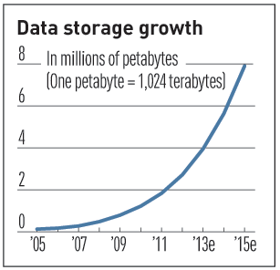
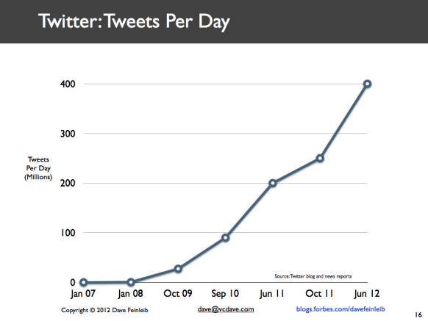
Volume (Scale)
Data Volume
44x increase from 2009 2020
From 0.8 zettabytes to 35zb
Data volume is increasing exponentially
Exponential increase in collected/generated data
Innovation and Inventions CST 156
16
16
16
www. cuchd.in Campus : Gharuan, Mohali
www. cuchd.in Campus : Gharuan, Mohali
www. cuchd.in Campus : Gharuan, Mohali
Innovation and Inventions CST 156
www. cuchd.in Campus : Gharuan, Mohali

Slide 17





4.6 billion camera phones world wide
30 billion RFID tags today (1.3B in 2005)
100s of millions of GPS enabled devices sold annually
? TBs of data every day
25+ TBs of log data every day
2+ billion people on the Web by end 2011
76 million smart meters in 2009… 200M by 2014
Fig no.3 sources of big data [3]

Slide 18
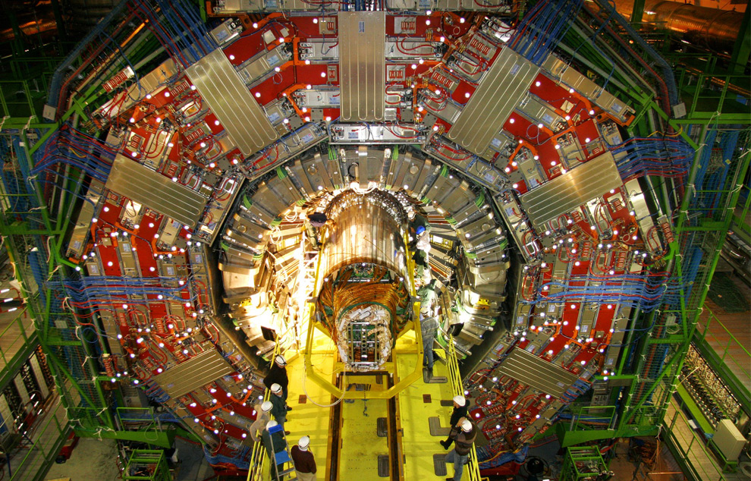
CERN’s Large Hydron Collider (LHC) generates 15 PB a year
Maximilien Brice, © CERN

Slide 19

The Earth scope
1.
The Earth scope is the world's largest science project. Designed to track North America's geological evolution, this observatory records data over 3.8 million square miles, amassing 67 terabytes of data. It analyzes seismic slips in the San Andreas fault, sure, but also the plume of magma underneath Yellowstone and much, much more.
Innovation and Inventions CST 156
19
19
www. cuchd.in Campus : Gharuan, Mohali
www. cuchd.in Campus : Gharuan, Mohali
www. cuchd.in Campus : Gharuan, Mohali
Innovation and Inventions CST 156
www. cuchd.in Campus : Gharuan, Mohali

Slide 20
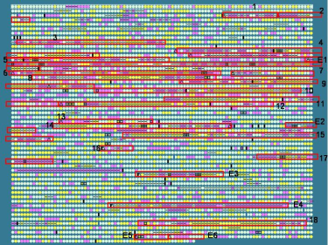
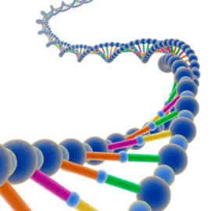
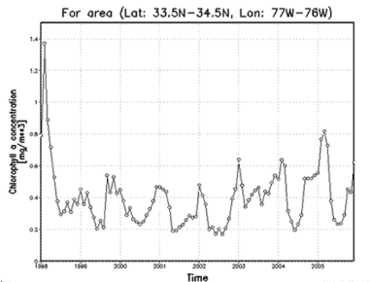


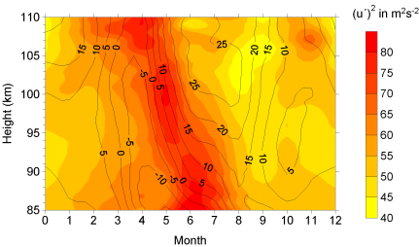
Variety (Complexity)
Relational Data (Tables/Transaction/Legacy Data)
Text Data (Web)
Semi-structured Data (XML)
Graph Data
Social Network, Semantic Web (RDF), …
Streaming Data
To extract knowledge➔ all these types of data need to linked together

Slide 21

















A Single View to the Customer
Social Media
Banking
Finance
Gaming
Our
Known
History
Customer
Entertain
Purchase
Fig no.4 single view to the customer [4]
Innovation and Inventions CST 156
21
21
www. cuchd.in Campus : Gharuan, Mohali
www. cuchd.in Campus : Gharuan, Mohali
www. cuchd.in Campus : Gharuan, Mohali
Innovation and Inventions CST 156
www. cuchd.in Campus : Gharuan, Mohali

Slide 22

Velocity (Speed)
Data is being generated fast and need to be processed fast
Online Data Analytics
Late decisions ➔ missing opportunities
Examples
E-Promotions: Based on your current location, your purchase history, what you like ➔ send promotions right now for store next to you
Healthcare monitoring: sensors monitoring your activities and body ➔ any abnormal measurements require immediate reaction
Innovation and Inventions CST 156
22
22
22
www. cuchd.in Campus : Gharuan, Mohali
www. cuchd.in Campus : Gharuan, Mohali
www. cuchd.in Campus : Gharuan, Mohali
Innovation and Inventions CST 156
www. cuchd.in Campus : Gharuan, Mohali

Slide 23

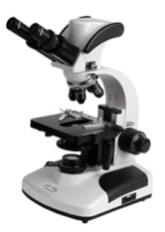

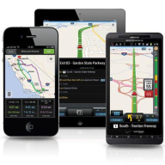


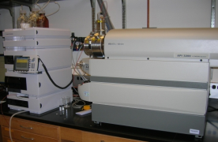
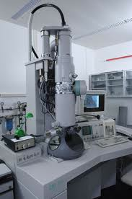
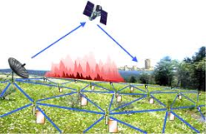

Real-time/Fast Data
Mobile devices
(tracking all objects all the time)
Social media and networks
(all of us are generating data)
Scientific instruments
(collecting all sorts of data)
Sensor technology and networks
(measuring all kinds of data)
The progress and innovation is no longer hindered by the ability to collect data.
Innovation and Inventions CST 156
23
23
23
www. cuchd.in Campus : Gharuan, Mohali
www. cuchd.in Campus : Gharuan, Mohali
www. cuchd.in Campus : Gharuan, Mohali
Innovation and Inventions CST 156
www. cuchd.in Campus : Gharuan, Mohali

Slide 24
Real-Time Analytics/Decision Requirement
Product
Recommendations
that are Relevant
& Compelling
Learning why Customers
Switch to competitors
and their offers; in
time to Counter
Influence
Behavior
Customer
Friend Invitations
to join a
Game or Activity
that expands
business
Improving the
Marketing
Effectiveness of a
Promotion while it
is still in Play
Preventing Fraud
as it is Occurring
& preventing more
proactively
Fig no.5 Decision requirement [5]

Slide 25
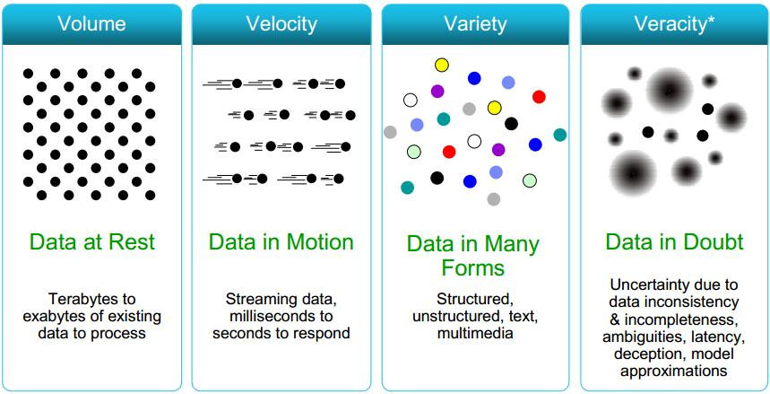
Some Make it 4V’s
Fig no.6 4V’s of big data [6]
Innovation and Inventions CST 156
25
25
25
www. cuchd.in Campus : Gharuan, Mohali
www. cuchd.in Campus : Gharuan, Mohali
www. cuchd.in Campus : Gharuan, Mohali
Innovation and Inventions CST 156
www. cuchd.in Campus : Gharuan, Mohali

Slide 26
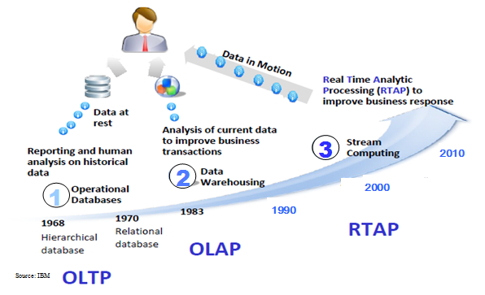
Harnessing Big Data
OLTP: Online Transaction Processing (DBMSs)
OLAP: Online Analytical Processing (Data Warehousing)
RTAP: Real-Time Analytics Processing (Big Data Architecture & technology)
Innovation and Inventions CST 156
26
26
26
www. cuchd.in Campus : Gharuan, Mohali
www. cuchd.in Campus : Gharuan, Mohali
www. cuchd.in Campus : Gharuan, Mohali
Innovation and Inventions CST 156
www. cuchd.in Campus : Gharuan, Mohali

Slide 27


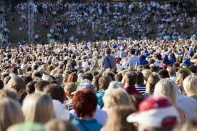

The Model Has Changed…
The Model of Generating/Consuming Data has Changed
Old Model: Few companies are generating data, all others are consuming data
New Model: all of us are generating data, and all of us are consuming data
Innovation and Inventions CST 156
27
27
27
www. cuchd.in Campus : Gharuan, Mohali
www. cuchd.in Campus : Gharuan, Mohali
www. cuchd.in Campus : Gharuan, Mohali
Innovation and Inventions CST 156
www. cuchd.in Campus : Gharuan, Mohali

Slide 28
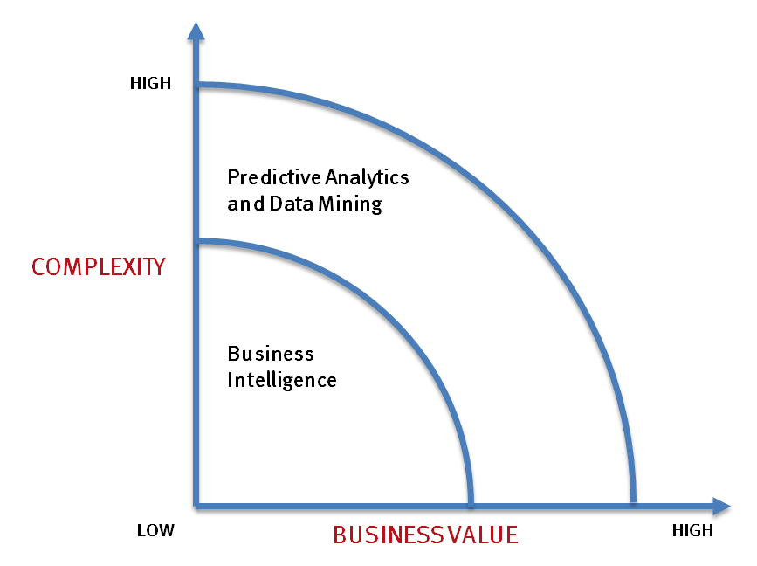
What’s driving Big Data
- Optimizations and predictive analytics
- Complex statistical analysis
- All types of data, and many sources
- Very large datasets
- More of a real-time
- Ad-hoc querying and reporting
- Data mining techniques
- Structured data, typical sources
- Small to mid-size datasets
Innovation and Inventions CST 156
28
28
28
www. cuchd.in Campus : Gharuan, Mohali
www. cuchd.in Campus : Gharuan, Mohali
www. cuchd.in Campus : Gharuan, Mohali
Innovation and Inventions CST 156
www. cuchd.in Campus : Gharuan, Mohali

Slide 29
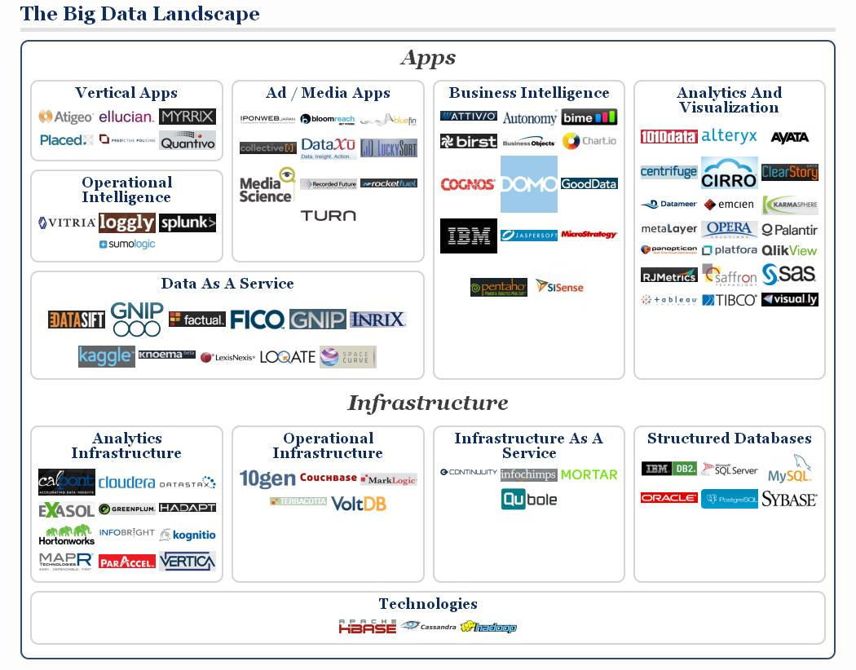
Innovation and Inventions CST 156
29
29
www. cuchd.in Campus : Gharuan, Mohali
www. cuchd.in Campus : Gharuan, Mohali
www. cuchd.in Campus : Gharuan, Mohali
Innovation and Inventions CST 156
www. cuchd.in Campus : Gharuan, Mohali

Slide 30
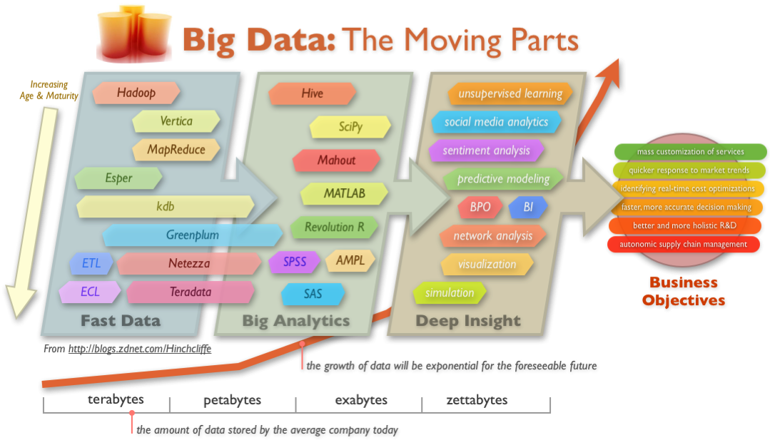
Big Data Technology
Innovation and Inventions CST 156
30
30
30
www. cuchd.in Campus : Gharuan, Mohali
www. cuchd.in Campus : Gharuan, Mohali
www. cuchd.in Campus : Gharuan, Mohali
Innovation and Inventions CST 156
www. cuchd.in Campus : Gharuan, Mohali

Slide 31
TOOLS
NoSQL DatabasesMongoDB, CouchDB, Cassandra, Redis, BigTable, Hbase, Hypertable, Voldemort, Riak, ZooKeeper
MapReduce Hadoop, Hive, Pig, Cascading, Cascalog, mrjob, Caffeine, S4, MapR, Acunu, Flume, Kafka, Azkaban, Oozie, Greenplum
Storage S3, Hadoop Distributed File System
Servers EC2, Google App Engine, Elastic, Beanstalk, Heroku
Processing R, Yahoo! Pipes, Mechanical Turk, Solr/Lucene, ElasticSearch, Datameer, BigSheets, Tinkerpop
Innovation and Inventions CST 156
31
31
www. cuchd.in Campus : Gharuan, Mohali
www. cuchd.in Campus : Gharuan, Mohali
www. cuchd.in Campus : Gharuan, Mohali
Innovation and Inventions CST 156
www. cuchd.in Campus : Gharuan, Mohali

Slide 32
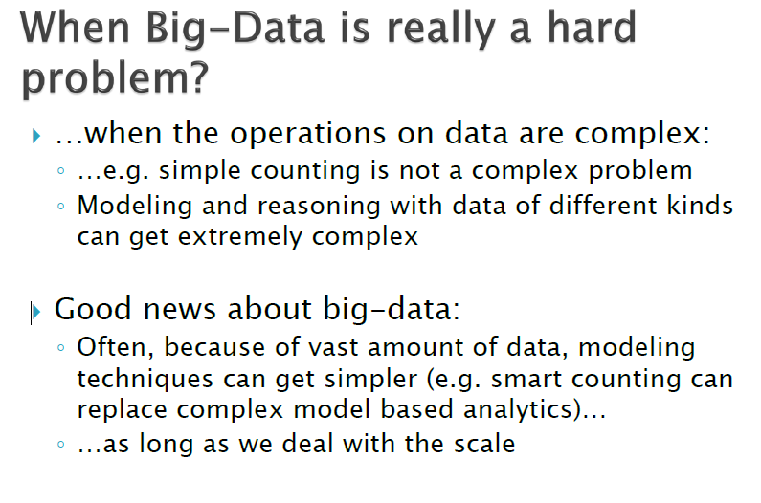
TECHNIQUES
Innovation and Inventions CST 156
32
32
www. cuchd.in Campus : Gharuan, Mohali
www. cuchd.in Campus : Gharuan, Mohali
www. cuchd.in Campus : Gharuan, Mohali
Innovation and Inventions CST 156
www. cuchd.in Campus : Gharuan, Mohali

Slide 33
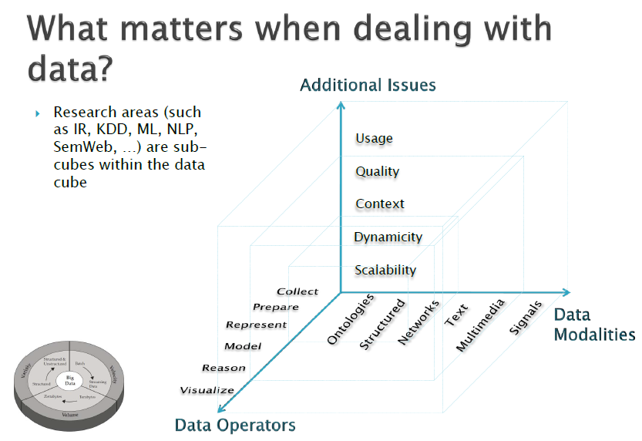
Innovation and Inventions CST 156
33
33
www. cuchd.in Campus : Gharuan, Mohali
www. cuchd.in Campus : Gharuan, Mohali
www. cuchd.in Campus : Gharuan, Mohali
Innovation and Inventions CST 156
www. cuchd.in Campus : Gharuan, Mohali

Slide 34
Applications of Big data
Innovation and Inventions CST 156
34
34
www. cuchd.in Campus : Gharuan, Mohali
www. cuchd.in Campus : Gharuan, Mohali
www. cuchd.in Campus : Gharuan, Mohali
Innovation and Inventions CST 156
www. cuchd.in Campus : Gharuan, Mohali

Slide 35
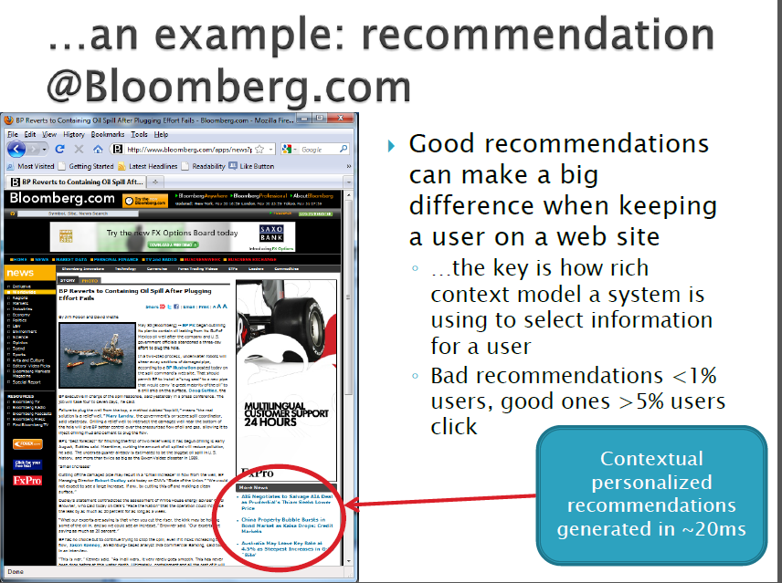
Fig no. 7 Bloomerg.com [7]
Innovation and Inventions CST 156
35
35
www. cuchd.in Campus : Gharuan, Mohali
www. cuchd.in Campus : Gharuan, Mohali
www. cuchd.in Campus : Gharuan, Mohali
Innovation and Inventions CST 156
www. cuchd.in Campus : Gharuan, Mohali

Slide 36
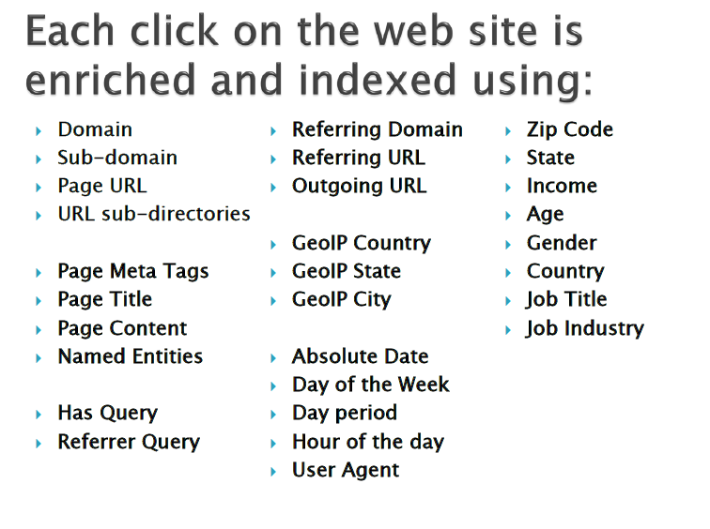
Innovation and Inventions CST 156
36
36
www. cuchd.in Campus : Gharuan, Mohali
www. cuchd.in Campus : Gharuan, Mohali
www. cuchd.in Campus : Gharuan, Mohali
Innovation and Inventions CST 156
www. cuchd.in Campus : Gharuan, Mohali

Slide 37
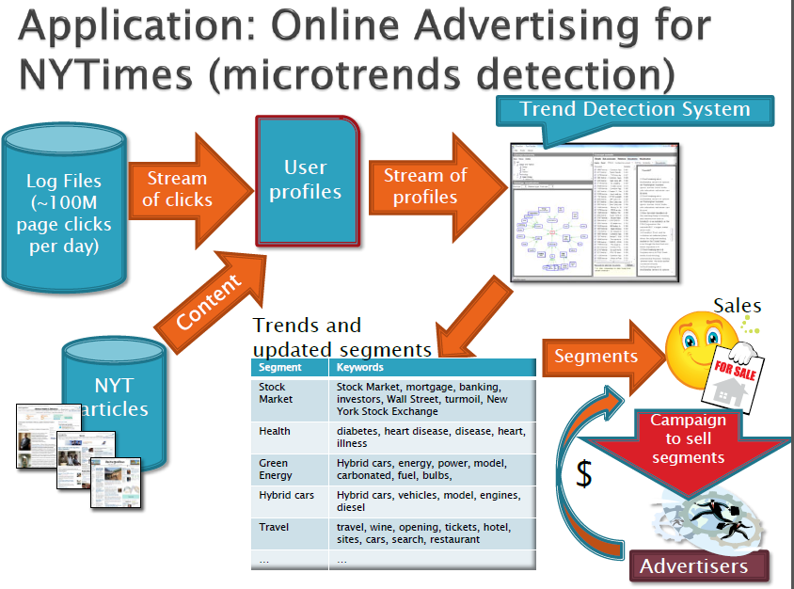
Fig no. 8 microtrend detection [8]
Innovation and Inventions CST 156
37
37
www. cuchd.in Campus : Gharuan, Mohali
www. cuchd.in Campus : Gharuan, Mohali
www. cuchd.in Campus : Gharuan, Mohali
Innovation and Inventions CST 156
www. cuchd.in Campus : Gharuan, Mohali

Slide 38
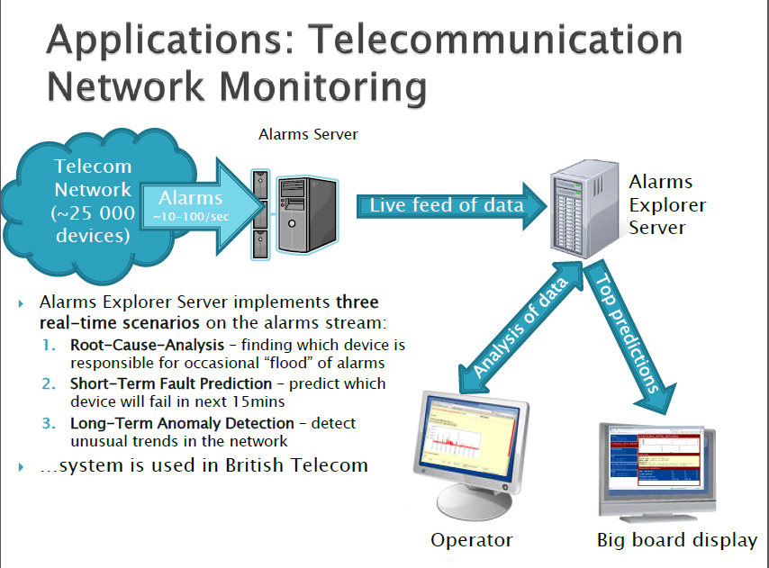
Fig no. 9 Network Monitoring [9]
Innovation and Inventions CST 156
38
38
www. cuchd.in Campus : Gharuan, Mohali
www. cuchd.in Campus : Gharuan, Mohali
www. cuchd.in Campus : Gharuan, Mohali
Innovation and Inventions CST 156
www. cuchd.in Campus : Gharuan, Mohali

Slide 39
FAQs
1) Explain the importance of Big Data?
2) State with examples the importance of this field.
3) “Future of Big Data is very vast”. Comment on this statement.
4) State the importance of 3 Vs of Big Data.
Innovation and Inventions CST 156
39
39
www. cuchd.in Campus : Gharuan, Mohali
www. cuchd.in Campus : Gharuan, Mohali
www. cuchd.in Campus : Gharuan, Mohali
Innovation and Inventions CST 156
www. cuchd.in Campus : Gharuan, Mohali

Slide 40
References
[1]. http://www.myassignmenthelp.net/big-data-analytics-and-hadoop
[2]. https://www.whishworks.com/blog/big-data/understanding-the-3-vs-of-big-data-volume-velocity-and-variety
[3] http://www.ibmbigdatahub.com/infographic/four-vs-big-data
[4] http://informationcatalyst.com/vision-experience/big-data-value/
[5] https://www.gartner.com/smarterwithgartner/six-best-practices-for-real-time-analytics/
[6] http://informationcatalyst.com/vision-experience/big-data-value/
[7] https://www.bloomberg.com/view/articles/2018-01-05/big-data-works-only-for-those-who-hype-it
[8] https://www.slideshare.net/markogrobelnik/big-data-tutorial-marko-grobelnik-25-may-2012
[9] http://www.mdpi.com/1424-8220/16/10/1706
Innovation and Inventions CST 156
40
40
www. cuchd.in Campus : Gharuan, Mohali
www. cuchd.in Campus : Gharuan, Mohali
www. cuchd.in Campus : Gharuan, Mohali
Innovation and Inventions CST 156
www. cuchd.in Campus : Gharuan, Mohali

